Slide 1
Deadlocks Lesson 3 Detection
David Liu
Fall 2021, Spring 2022

Slide 2
Deadlock Detection
Allow system to enter deadlock state
Detection algorithm
Recovery scheme

Slide 3
Deadlock Detection Approaches
Single Instance of Each Resource Type
Several Instances of a Resource Type

Slide 4
Single Instance of Each Resource Type
Maintain wait-for graph of Processes
Nodes are processes
P_{i} → P_{j} if P_{i} is waiting for P_{j}
Periodically invoke an algorithm that searches for a cycle in the graph. If there is a cycle, there exists a deadlock
An algorithm to detect a cycle in a graph requires an order of n² operations, where n is the number of vertices in the graph

Slide 5
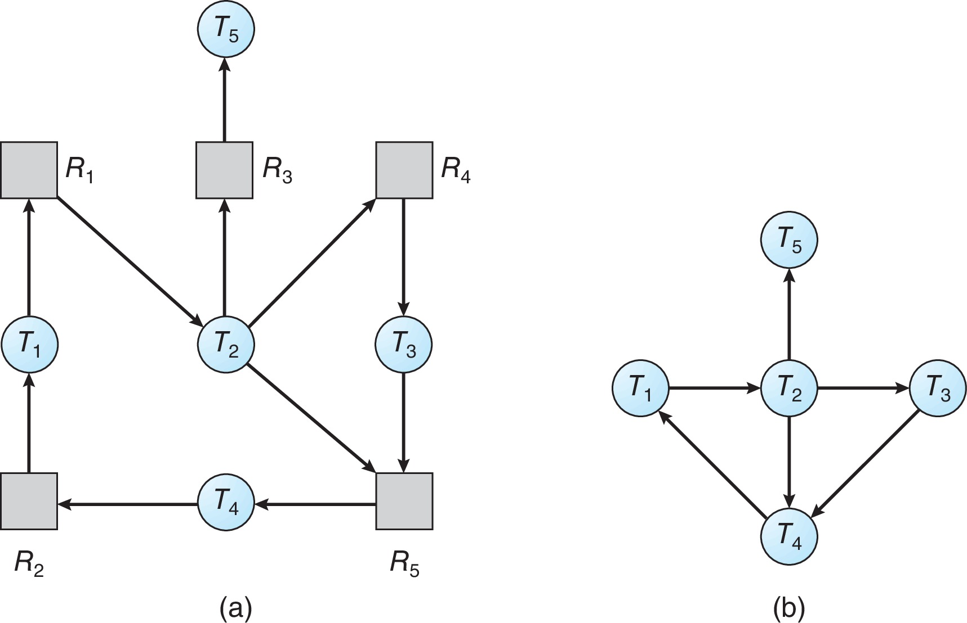
Resource-Allocation Graph and Wait-for Graph
Resource-Allocation Graph
Corresponding wait-for graph

Slide 6
Several Instances of a Resource Type
Available: A vector of length m indicates the number of available resources of each type
Allocation: An n x m matrix defines the number of resources of each type currently allocated to each process
Request: An n x m matrix indicates the current request of each process. If Request [i][j] = k, then process P_{i} is requesting k more instances of resource type R_{j}.

Slide 7
Detection Algorithm
1. Let Work and Finish be vectors of length m and n, respectively Initialize:
(a) Work = Available
(b) For i = 1,2, …, n, if Allocation_{i} ≠ 0, then Finish[i] = false; otherwise, Finish[i] = true
2. Find an index i such that both:
(a) Finish[i] == false
(b) Request_{i} ≤ Work
If no such i exists, go to step 4

Slide 8
Detection Algorithm (Cont.)
3. Work = Work + Allocation_{i} Finish[i] = true go to step 2
4. If Finish[i] == false, for some i, 1 ≤ i ≤ n, then the system is in deadlock state. Moreover, if Finish[i] == false, then P_{i} is deadlocked
Algorithm requires an order of O(m x n²) operations to detect whether the system is in deadlocked state

Slide 9
Question
What difference
between Safety Algorithm
and Detection Algorithm

Slide 10
Safety vs Detection Algorithms
1. Let Work and Finish be vectors of length m and n, respectively. Initialize:
Work = Available
Finish [i] = false for i = 0, 1, …, n- 1
2. Find an i such that both:
(a) Finish [i] = false
(b) Need_{i} ≤ Work
If no such i exists, go to step 4
3. Work = Work + Allocation_{i} Finish[i] = true go to step 2
4. If Finish [i] == true for all i,
then the system is in a safe state
else
the system is in a unsafe state
1. Let Work and Finish be vectors of length m and n, respectively Initialize:
(a) Work = Available
(b) For i = 1,2, …, n, if Allocationi ≠ 0, then Finish[i] = false; otherwise, Finish[i] = true
2. Find an index i such that both:
(a) Finish[i] == false
(b) Request_{i} ≤ Work
If no such i exists, go to step 4
3. Work = Work + Allocation_{i} Finish[i] = true go to step 2
4. If Finish[i] == false, for some i, 1 ≤ i ≤ n, then the system is in deadlock state. Moreover, if Finish[i] == false, then P_{i} is deadlocked

Slide 11
Example of Detection Algorithm
Five processes P₀ through P₄; three resource types A (7 instances), B (2 instances), and C (6 instances)
Snapshot at time T₀:
Allocation Request Available
A B C A B C A B C
P₀ 0 1 0 0 0 0 0 0 0
P₁ 2 0 0 2 0 2
P₂ 3 0 3 0 0 0
P₃ 2 1 1 1 0 0
P₄ 0 0 2 0 0 2
Sequence <P₀, P₂, P₃, P₁, P₄> will result in Finish[i] = true for all i

Slide 12
Example (Cont.)
P₂ requests an additional instance of type C
Request
A B C
P₀ 0 0 0
P₁ 2 0 2
P₂ 0 0 1
P₃ 1 0 0
P₄ 0 0 2
State of system?
Can reclaim resources held by process P₀, but insufficient resources to fulfill other processes; requests
Deadlock exists, consisting of processes P₁, P₂, P₃, and P₄

Slide 13
Detection-Algorithm Usage
When, and how often, to invoke depends on:
How often a deadlock is likely to occur?
How many processes will need to be rolled back?
one for each disjoint cycle
Every time a request for allocation cannot be granted
If detection algorithm is invoked arbitrarily, there may be many cycles in the resource graph and so we would not be able to tell which of the many deadlocked processes “caused” the deadlock.

Slide 14
Recovery from Deadlock
Process Termination or
Resource Preemption

Slide 15
Recovery from Deadlock: Process Termination
Abort all deadlocked processes
Abort one process at a time until the deadlock cycle is eliminated
In which order should we choose to abort?
Priority of the process
How long process has computed, and how much longer to completion
Resources the process has used
Resources process needs to complete
How many processes will need to be terminated
Is process interactive or batch?

Slide 16
Recovery from Deadlock: Resource Preemption
Goal: Successively preempt some resources from processes and give these resources to other processes until the deadlock cycle is broken
Issues
Selecting a victim – minimize cost
Rollback – return to some safe state, restart process for that state
Starvation – same process may always be picked as victim, include number of rollback in cost factor

